Slide 1

SERVICE
MANAGEMENT
Presented By : LT 6

Slide 2





Service Management: A Customer-Centric IT Approach
Emphasizes delivering value to customers
Prioritizes strong customer relationships
Structures IT activities and technical interactions
Framework for enhancing customer and client engagement

Slide 3
IT Service Management (ITSM)
Aligns IT systems operation with service provision
Aims for stable and efficient IT operations
Facilitates effective service delivery
Essential for consistent service quality

Slide 4
Information Technology Infrastructure Library (ITIL)
Definition: A set of best practices for IT service management (ITSM)
Objective: To optimize risk management, enhance customer relations, and ensure cost-effective operations
Benefits:
Reduces IT operational costs
Boosts productivity and employee satisfaction
Manages risks, failures, and disruptions effectively
Focus: Integrating IT into the business for stability and growth
Latest Version: ITIL 4, emphasizing agility and flexibility in IT departments

Slide 5
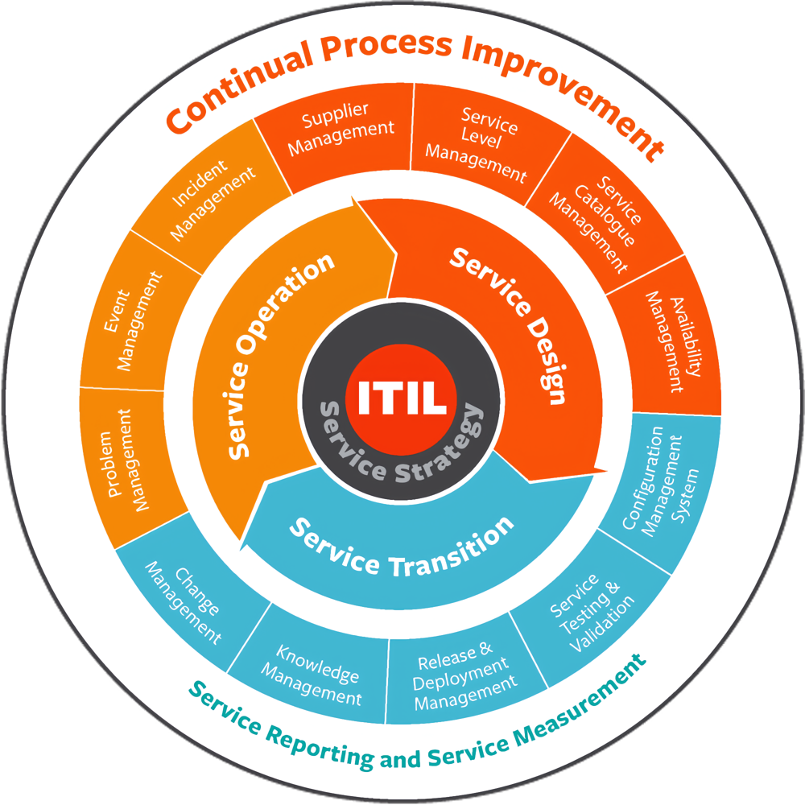
The Evolution of ITIL
From 30 to 5 Volumes:
Original Framework: 30 comprehensive books
Version 2 (2000): Simplified to 7 focused volumes
2007 Edition: Further condensed to 5 volumes covering 26 processes/functions
2011 Refresh:
Maintained the five-volume structure
Enhanced clarity and usability
ITIL 4 (2019):
Updates for modern technology and practices
Aims for a more agile, flexible, and collaborative approach
Keeps IT aligned with business needs and future challenges

Slide 6




Processes
of Service Support

Slide 7




Incident Management
Involves coordinating incident resolution with specialist support groups, aiming to restore IT services swiftly to defined service levels, and ensuring users are informed at regular intervals about their incident statuses.

Slide 8



Service Desk
Focuses on restoring IT services to their defined service levels promptly, receiving and processing service requests, assisting users with inquiries and issues, and providing regular updates on incident statuses.
.

Slide 9


Problem management
To resolve the root cause of Incidents, and to prevent the recurrence of Incidents related to these errors. It provides Incident Management with Temporary Fixes and Permanent Solutions to Known Errors. Proactive Problem Management identifies and resolves Problems before Incidents occur.

Slide 10



Configuration management
The information about Infrastructure and Services necessary for the IT Service Management is made available by Configuration Management. Changes are documented and the updated status of the information is regularly checked. With this, updated and historical information as to the Configuration Items are continuously available within the Configuration Management Database .

Slide 11


Change Management
All Changes to the IT infrastructure and its components (Configuration Items) are authorized and documented, in order to ensure that interruptive effects upon the running operation are kept to a minimum. The implementation steps are planned and communicated, in order to recognize potential side-effects as early as possible. The Change Manager and (for further-reaching Changes) the Change Advisory Board (CAB) bear the responsibility for this. A specific procedure is in existence for emergencies, dealing with Urgent Changes.

Slide 12




Release management
Is the central responsible body for the implementation of Changes to the IT Infrastructure, so that these are carried out in an effective, secure and verifiable manner. Their tasks include planning, monitoring and implementation of respective Rollouts or Rollins in co-ordination with Change Management.

Slide 13






Service delivery
Service delivery is a business idea and framework, the main goal of which is to provide services from a vendor to a customer. This includes the regular interactions between the two parties throughout the entire process of the business supplying the service and the client purchasing it.
Service delivery within the ITIL framework encompasses a set of processes aimed at implementing long-term plans and improvements for IT services. These processes are crucial for ensuring that IT services meet the needs of the users efficiently and effectively.

Slide 14


Service Level Management
Service Level Management (SLM) is a critical process within service delivery. It involves maintaining and enhancing service levels based on agreements between the IT service provider and the user. SLM ensures that IT services align with the business needs and expectations. Key activities within SLM include defining service level agreements (SLAs), monitoring service performance, and continuously improving service levels to meet evolving requirements. By establishing clear metrics and objectives, SLM enables transparency, accountability, and customer satisfaction.

Slide 15


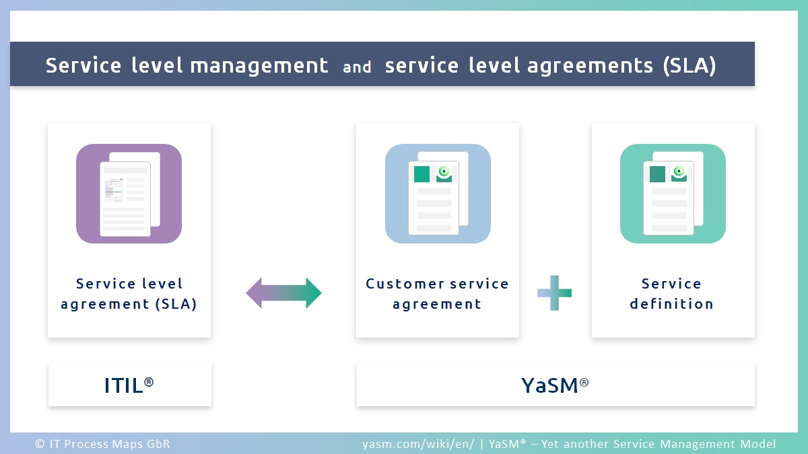
Service Level Management

Slide 16

IT Service Financial Management
IT Service Financial Management focuses on managing the costs required to provide IT services. This process ensures that IT resources are allocated effectively and efficiently to maximize value while minimizing expenses. It involves budgeting, accounting, and cost optimization activities to ensure financial viability and transparency in IT service delivery. By aligning IT expenditures with business objectives and priorities, financial management facilitates informed decision-making and resource allocation.

Slide 17


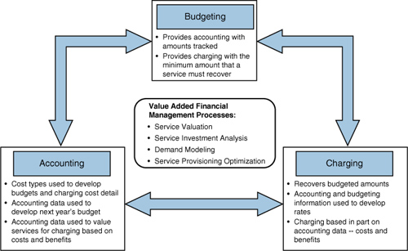




Slide 18
Capacity Management
Capacity Management is essential for ensuring that IT services meet performance requirements while considering budget constraints and cost-effectiveness. This process involves forecasting, planning, and optimizing IT infrastructure, resources, and capabilities to support current and future business demands. Capacity Management aims to prevent performance bottlenecks, optimize resource utilization, and maintain service levels even during peak usage periods. By aligning capacity with business needs, organizations can enhance productivity, resilience, and agility.

Slide 19



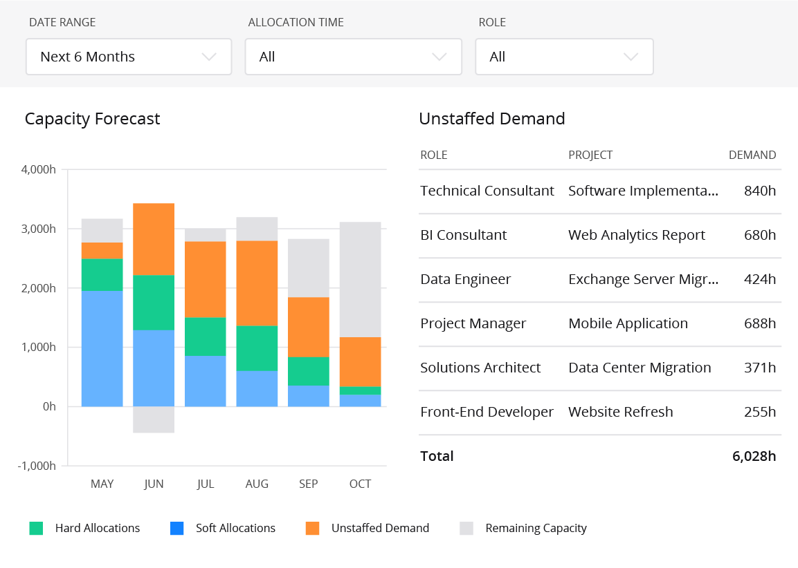



Slide 20

IT Service Continuity Management
IT Service Continuity Management is a crucial process designed to prevent IT service disruptions, particularly during unforeseen events such as natural disasters or emergencies. It involves developing and implementing strategies, plans, and measures to ensure the uninterrupted delivery of IT services and minimize the impact of disruptions. This includes disaster recovery planning, backup systems, and contingency arrangements to mitigate risks and maintain business continuity. IT Service Continuity Management safeguards against potential downtime, data loss, and reputational damage, enhancing organizational resilience and preparedness.

Slide 21


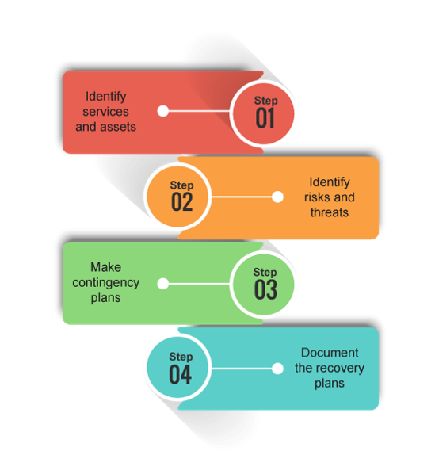


Slide 22


Availability Management
Availability Management focuses on managing the quality and accessibility of IT services to meet business requirements. This process ensures that IT infrastructure, systems, and components are available when needed to support business operations. Availability Management involves monitoring, measuring, and optimizing service availability, reliability, and performance. It includes proactive measures such as fault prevention, redundancy, and failover mechanisms to minimize downtime and maximize service uptime. By maintaining high levels of availability, organizations can enhance user satisfaction, productivity, and competitiveness.

Slide 23
Facility Management

Slide 24
Facility Management
refers to the practice of managing and maintaining an organization's physical assets, infrastructure, and facilities to ensure they support the organization's goals and operations effectively.

Slide 25
Key Components
Maintenance of IT Infrastructure
Equipment Maintenance
Physical Facilities Management
Safety and Compliance

Slide 26
Benefits
Improved Operational Efficiency
Cost Savings
Enhanced Safety

Slide 27

S.E.D
System Environment
Development

Slide 28
Defination
System Environment Development involves implementing proactive measures to mitigate risks associated with natural disasters, accidents, and equipment malfunctions. It encompasses regular checks and maintenance of critical components such as windows, air conditioning, and power systems.

Slide 29
Importance
System Environment Development is vital for safeguarding against disruptions that can affect operational continuity. In real-world scenarios, its importance is evident in various ways:
.
Mitigating Natural Disasters
Preventing Equipment Failures
Enhancing Security

Slide 30




Importance
Mitigating Natural Disasters
Preventing Equipment
Failures
Enhancing Security
Robust infrastructure measures, such as earthquake-resistant building designs and flood prevention systems, reduce the risk of downtime and data loss during natural calamities.
Measures like fire alarms, suppression systems, and emergency response plans mitigate the risk of data loss and downtime in the event of accidents or security breaches.
Regular maintenance and checks on critical components help identify and rectify issues before they escalate, ensuring uninterrupted operations.
.

Slide 31
Addition Measure & Mentainance
Implementing additional measures and maintenance procedures is crucial for enhancing the resilience and robustness of the system environment. Here are some further details
.
Regular Inspections and Audits
Documentation and Training
Environmental Monitoring
Vendor Management
Disaster Recovery & Business Continuity Planning

Slide 32
Strategies for Resilience and Efficiency
Environmental Monitoring
Deploy environmental monitoring tools and sensors to continuously monitor critical parameters such as temperature, humidity, air quality, and power consumption.
Documentation and Training
Maintain comprehensive documentation of system configurations, architecture diagrams, operational procedures, and troubleshooting guides to facilitate efficient maintenance and support activities.

Slide 33
Strategies for Resilience and Efficiency
Vendor Management
Establish strong vendor relationships and partnerships to access timely support, maintenance services, and product updates for hardware, software, and other system components.
Regular Inspections and Audits
Conduct scheduled inspections and audits of the system environment to identify any potential vulnerabilities, weaknesses, or non-compliance issues.

Slide 34
Strategies for Resilience and Efficiency
Disaster Recovery & Business Continuity Planning
Develop robust disaster recovery (DR) and business continuity (BC) plans outlining procedures for mitigating the impact of disruptive events on system operations.
Conduct regular DR/BC drills and exercises to test the effectiveness of contingency plans and identify areas for improvement.

Slide 35

?
SUMMARY S.E.D
implementing these additional measures and maintenance procedures, organizations can strengthen the resilience and robustness of their system environments, mitigate risks, and ensure the continuity of critical business operations in the face of evolving threats and challenges.

Slide 36
System Audit
- systematic examination of an organization's information systems
- ensure they are functioning effectively, securely, and in accordance
PURPOSE
IMPORTANCE
- Assessment of Controls
- Risk Identification
- Compliance Verification
- Security Assurance
- Compliance Adherence
- Risk Management
CHRIS MARKLEN FERNANDEZ

Slide 37
Process in System Audit
CHRIS MARKLEN FERNANDEZ

Slide 38
Process in System Audit
PLANNING
FORMULATION OF AUDIT PLAN
IMPLEMENTATION
PRELIMINARY AUDIT
MAIN AUDIT
PREPARATION OF SYSTEM AUDIT REPORT
REPORTING
OPINION EXCHANGE MEETING
AUDIT REPORT MEETING
FOLLOW-UP

Slide 39
THANK YOU
Presented By : LT 6

